Slide 1

Electric water heater
Graduation project for Amit
Made by:
Ibrahim Mohamed ismael Mahmoud Sayed Ramadan

Slide 2
Table of contents
System architecture
System Specifications
Flow chart
Test cases

Slide 3

System architecture
External EEPROM
Input /output diagram
Micro controller
up\down button
Heating\cooling element
on\off button
Seven segment
Temperature sensor
heating element led

Slide 4
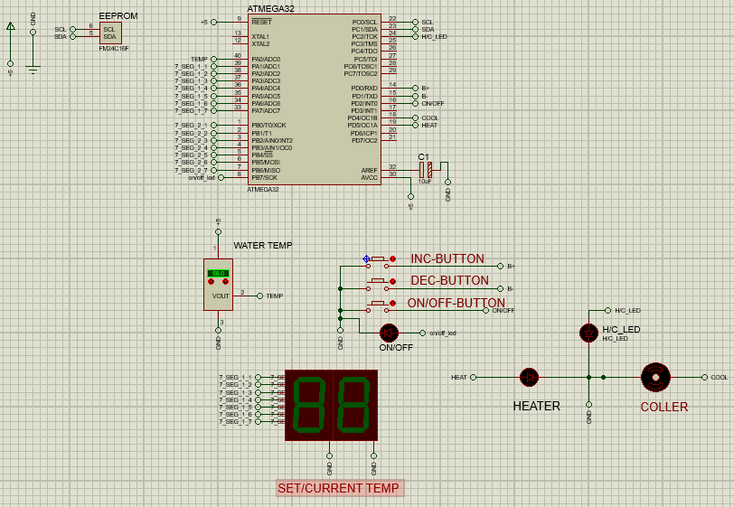
System architecture
Proteus diagram
INPUTS
OUTPUTS

Slide 5
System Specifications
Temperature Setting
ON/OFF Behavior
Temperature Sensing
Heating/Cooling Elements
Seven Segments
Heating Element Led

Slide 6
System Specifications
Temperature Setting
ON/OFF Behavior
Temperature Sensing
Heating/Cooling Elements
Seven Segments
Heating Element Led

Slide 7
Temperature Setting
The “Up” or “Down” buttons are used to change the required water temperature (set temperature).
The first “Up” or “Down” button press, enters the temperature setting mode.
After entering temperature setting mode, a single “Up” button press increase the set temperature by 5 degrees.
After entering temperature setting mode, a single “Down” button press decrease the set temperature by 5 degrees.
The minimum possible set temperature is 35 degrees.
The maximum possible set temperature is 75 degrees.
The “External EEPROM” should save the set temperature once set.
If the electric water heater is turned OFF then ON, the stored set
Temperature should be retrieved from the “External EEPROM”.
The initial set temperature is 60 degrees.

Slide 8
System Specifications
Temperature Setting
ON/OFF Behavior
Temperature Sensing
Heating/Cooling Elements
Seven Segments
Heating Element Led

Slide 9

ON/OFF Behavior
If power is connected to the heater , the electric water heater is in OFF state.
If the “ON/OFF” button is released and the electric water heater is in OFF state, the electric water heater goes to ON state.
If the “ON/OFF” button is released and the electric water heater is in ON state, the electric water heater goes to OFF state.
In the OFF state, all display should be turned OFF

Slide 10
System Specifications
Temperature Setting
ON/OFF Behavior
Temperature Sensing
Heating/Cooling Elements
Seven Segments
Heating Element Led

Slide 11
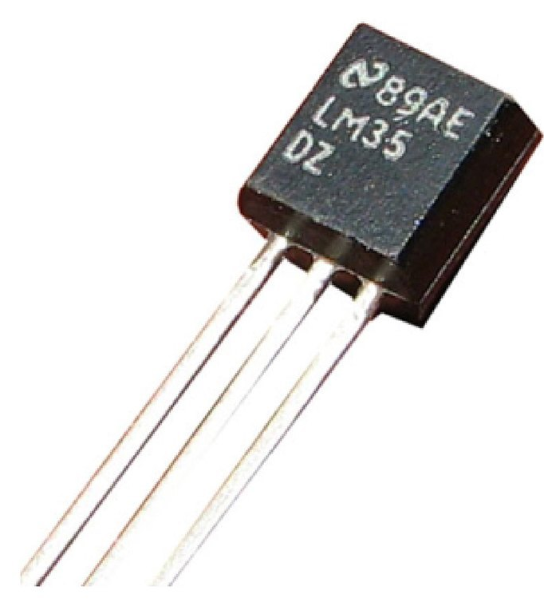
Temperature Sensing
The temperature sensor measures the water temperature.
The water temperature should increase, if the “Heating Element” is ON.
The water temperature should decrease, if the “Cooling Element” is ON.
Temperature should be sensed once every 100 ms.
The decision to turn ON or OFF either the “Heating Element” or the “Cooling Element” based on the average of the last 10 temperature readings.

Slide 12
System Specifications
Temperature Setting
ON/OFF Behavior
Temperature Sensing
Heating/Cooling Elements
Seven Segments
Heating Element Led

Slide 13
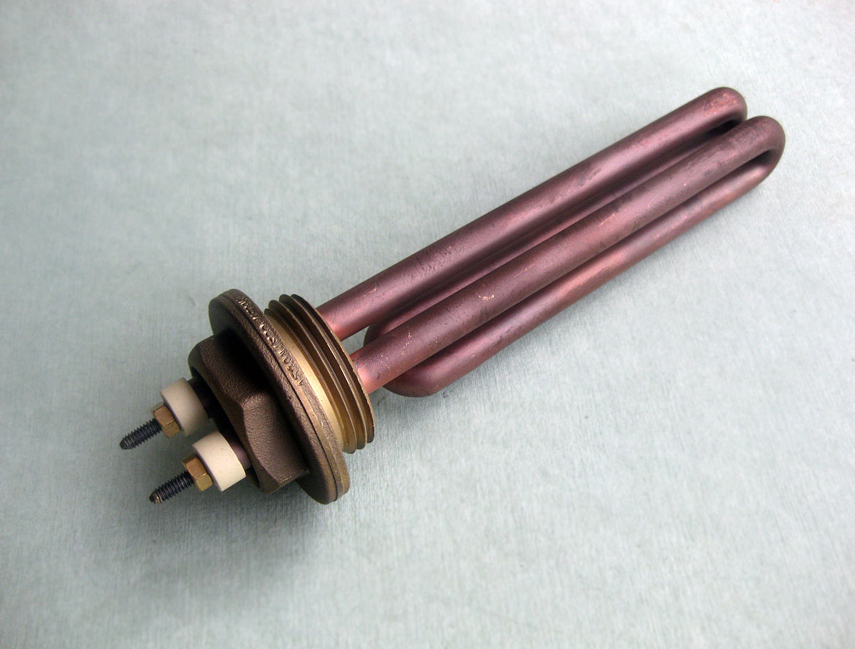
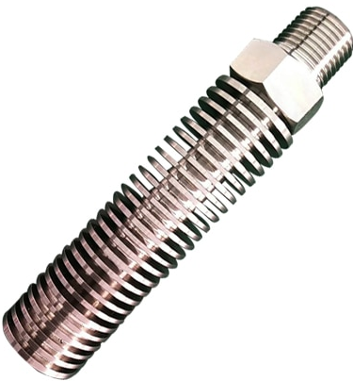
Heating/Cooling Elements
The “Heating Element” should be turned ON, if the current water temperature is less than the set temperature by 5 degrees.
The “Cooling Element” should be turned OFF, if the current water temperature is less than the set temperature by 5 degrees.
The “Heating Element” should be turned OFF, if the current water temperature is greater than the set temperature by 5 degrees.
The “Cooling Element” should be turned ON, if the current water temperature is greater than the set temperature by 5 degrees

Slide 14
System Specifications
Temperature Setting
ON/OFF Behavior
Temperature Sensing
Heating/Cooling Elements
Seven Segments
Heating Element Led

Slide 15
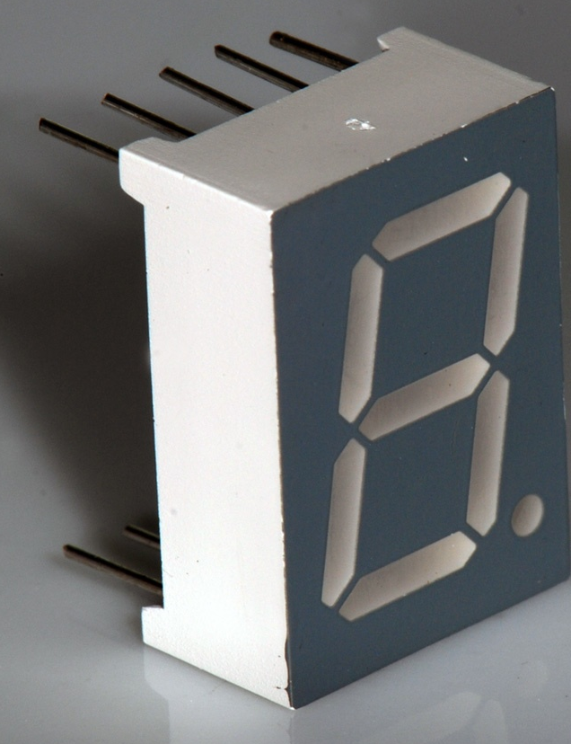
Seven Segments
Seven segment by default show the current water temperature or the set temperature.
By default, the 2 seven segment display are show the current water temperature.
If the electric water heater is in the temperature setting mode, the 2 seven segment displays should blink every 1 second and show the set temperature.
In the temperature setting mode, every change in the set temperature should be reflected on the 2 seven segment displays.
The 2 seven segment display should exit the temperature setting mode, if the “UP” and “Down” buttons are not pressed for 5 seconds

Slide 16
System Specifications
Temperature Setting
ON/OFF Behavior
Temperature Sensing
Heating/Cooling Elements
Seven Segments
Heating Element Led

Slide 17
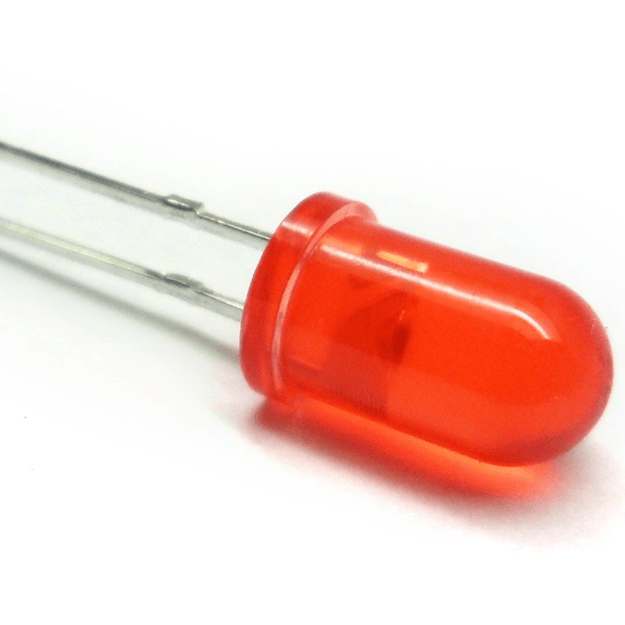
Heating Element Led
If the “Heating Element” is ON, the “Heating Element Led” should blink every 1 second.
If the “Cooling Element” is ON, the “Heating Element Led” should be ON

Slide 18
Flow chart
START
Initialize all actuators and peripherals (LEDs, Buttons, Timer,7-segments ,ADC (Temp sensor), Heater, Cooling) and send initial temp to EEPROM
While (1)
A
IF (System is off)
NO
B
YES
Heater and cooler off and all LEDs
READ water temperature
1

Slide 19
Flow chart
1
B
IF up Button pressed
IF Down Button pressed
IF on/off Button pressed
NO
NO
NO
C
Setting mode on ,Timer on and Blink 7-segments
YES
YES
YES
IF Setting mode off
IF Setting mode off
IF first press
YES
YES
NO
System off
And no press
NO
NO
YES
D
B
Set Temp+5
Set Temp-5
System on
E
C
Write Set Temp on 7-segment
IF (System on)
NO
A
IF 5 sec passed after last press
YES
NO
Write water Temp on 7-segment
Read water temp every 100 ms & store
E
YES
D
2

Slide 20
Flow chart
2
Water temp = average of last 10 readings
IF (water temp ≈ req temp )
NO
IF (water temp < req temp -5 )
NO
IF (water temp > req temp + 5 )
NO
A
YES
YES
YES
IF (pass 4 minutes &
water temp ≈ req temp )
Heater on
cooler off
cooler on
Heater off
NO
A
A
Only if the power off
YES
System off
END
A

Slide 21
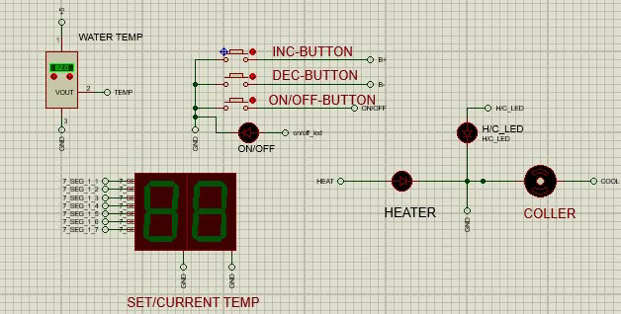
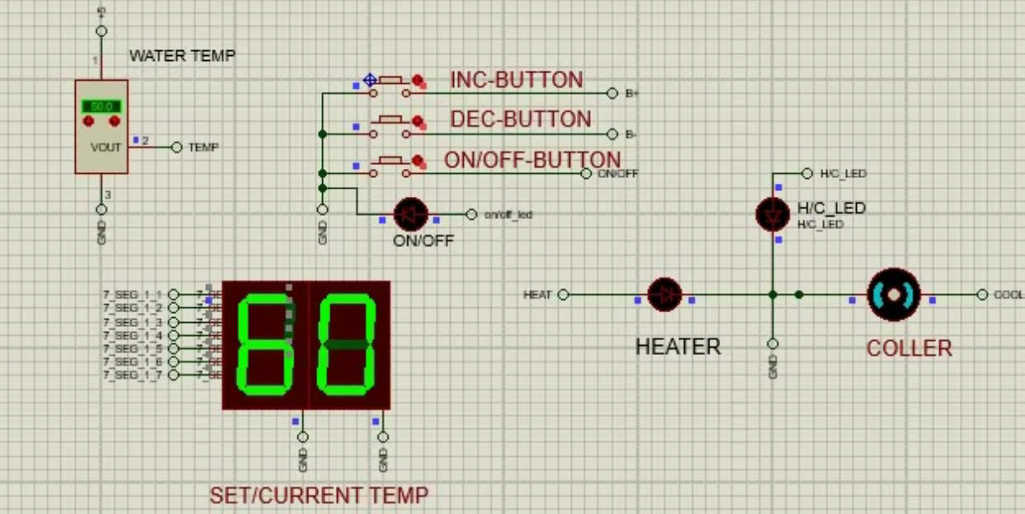
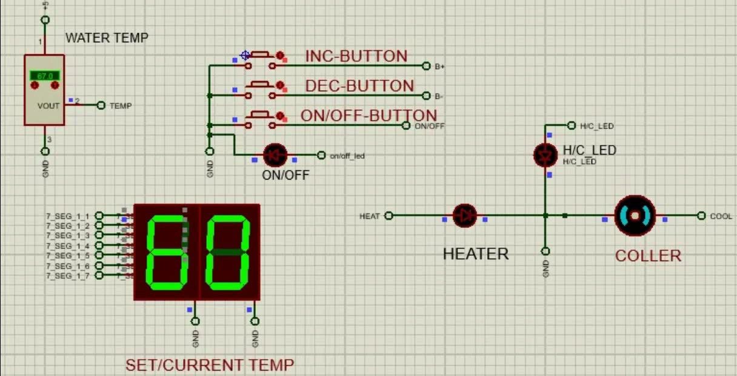
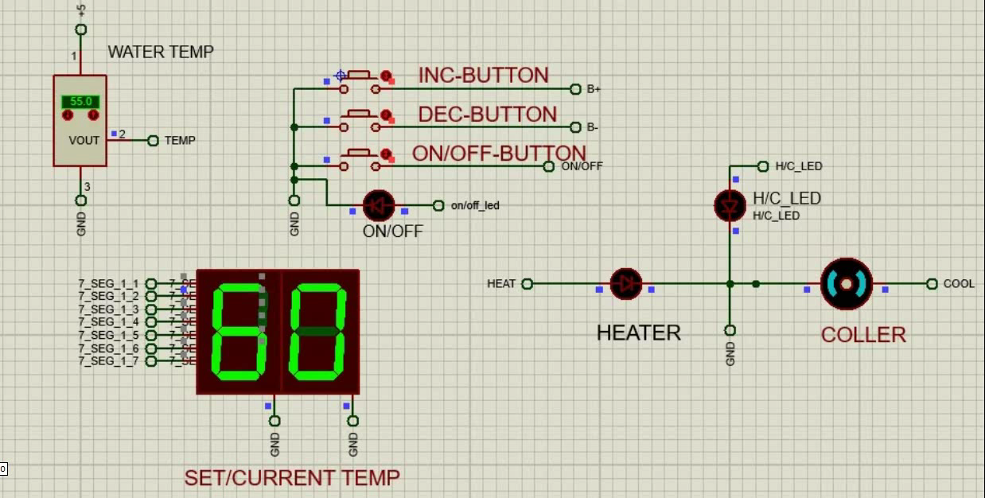
Testcases
Test case 1 : IF (water temp ≈ req temp )
Test case 2 : IF (water temp > req temp+5)
Test case 3 : IF (water temp < req temp-5)
Test case 4 : Forgot to on the system

Slide 22

Any questions

Slide 23
Thank
You

